Slide 1

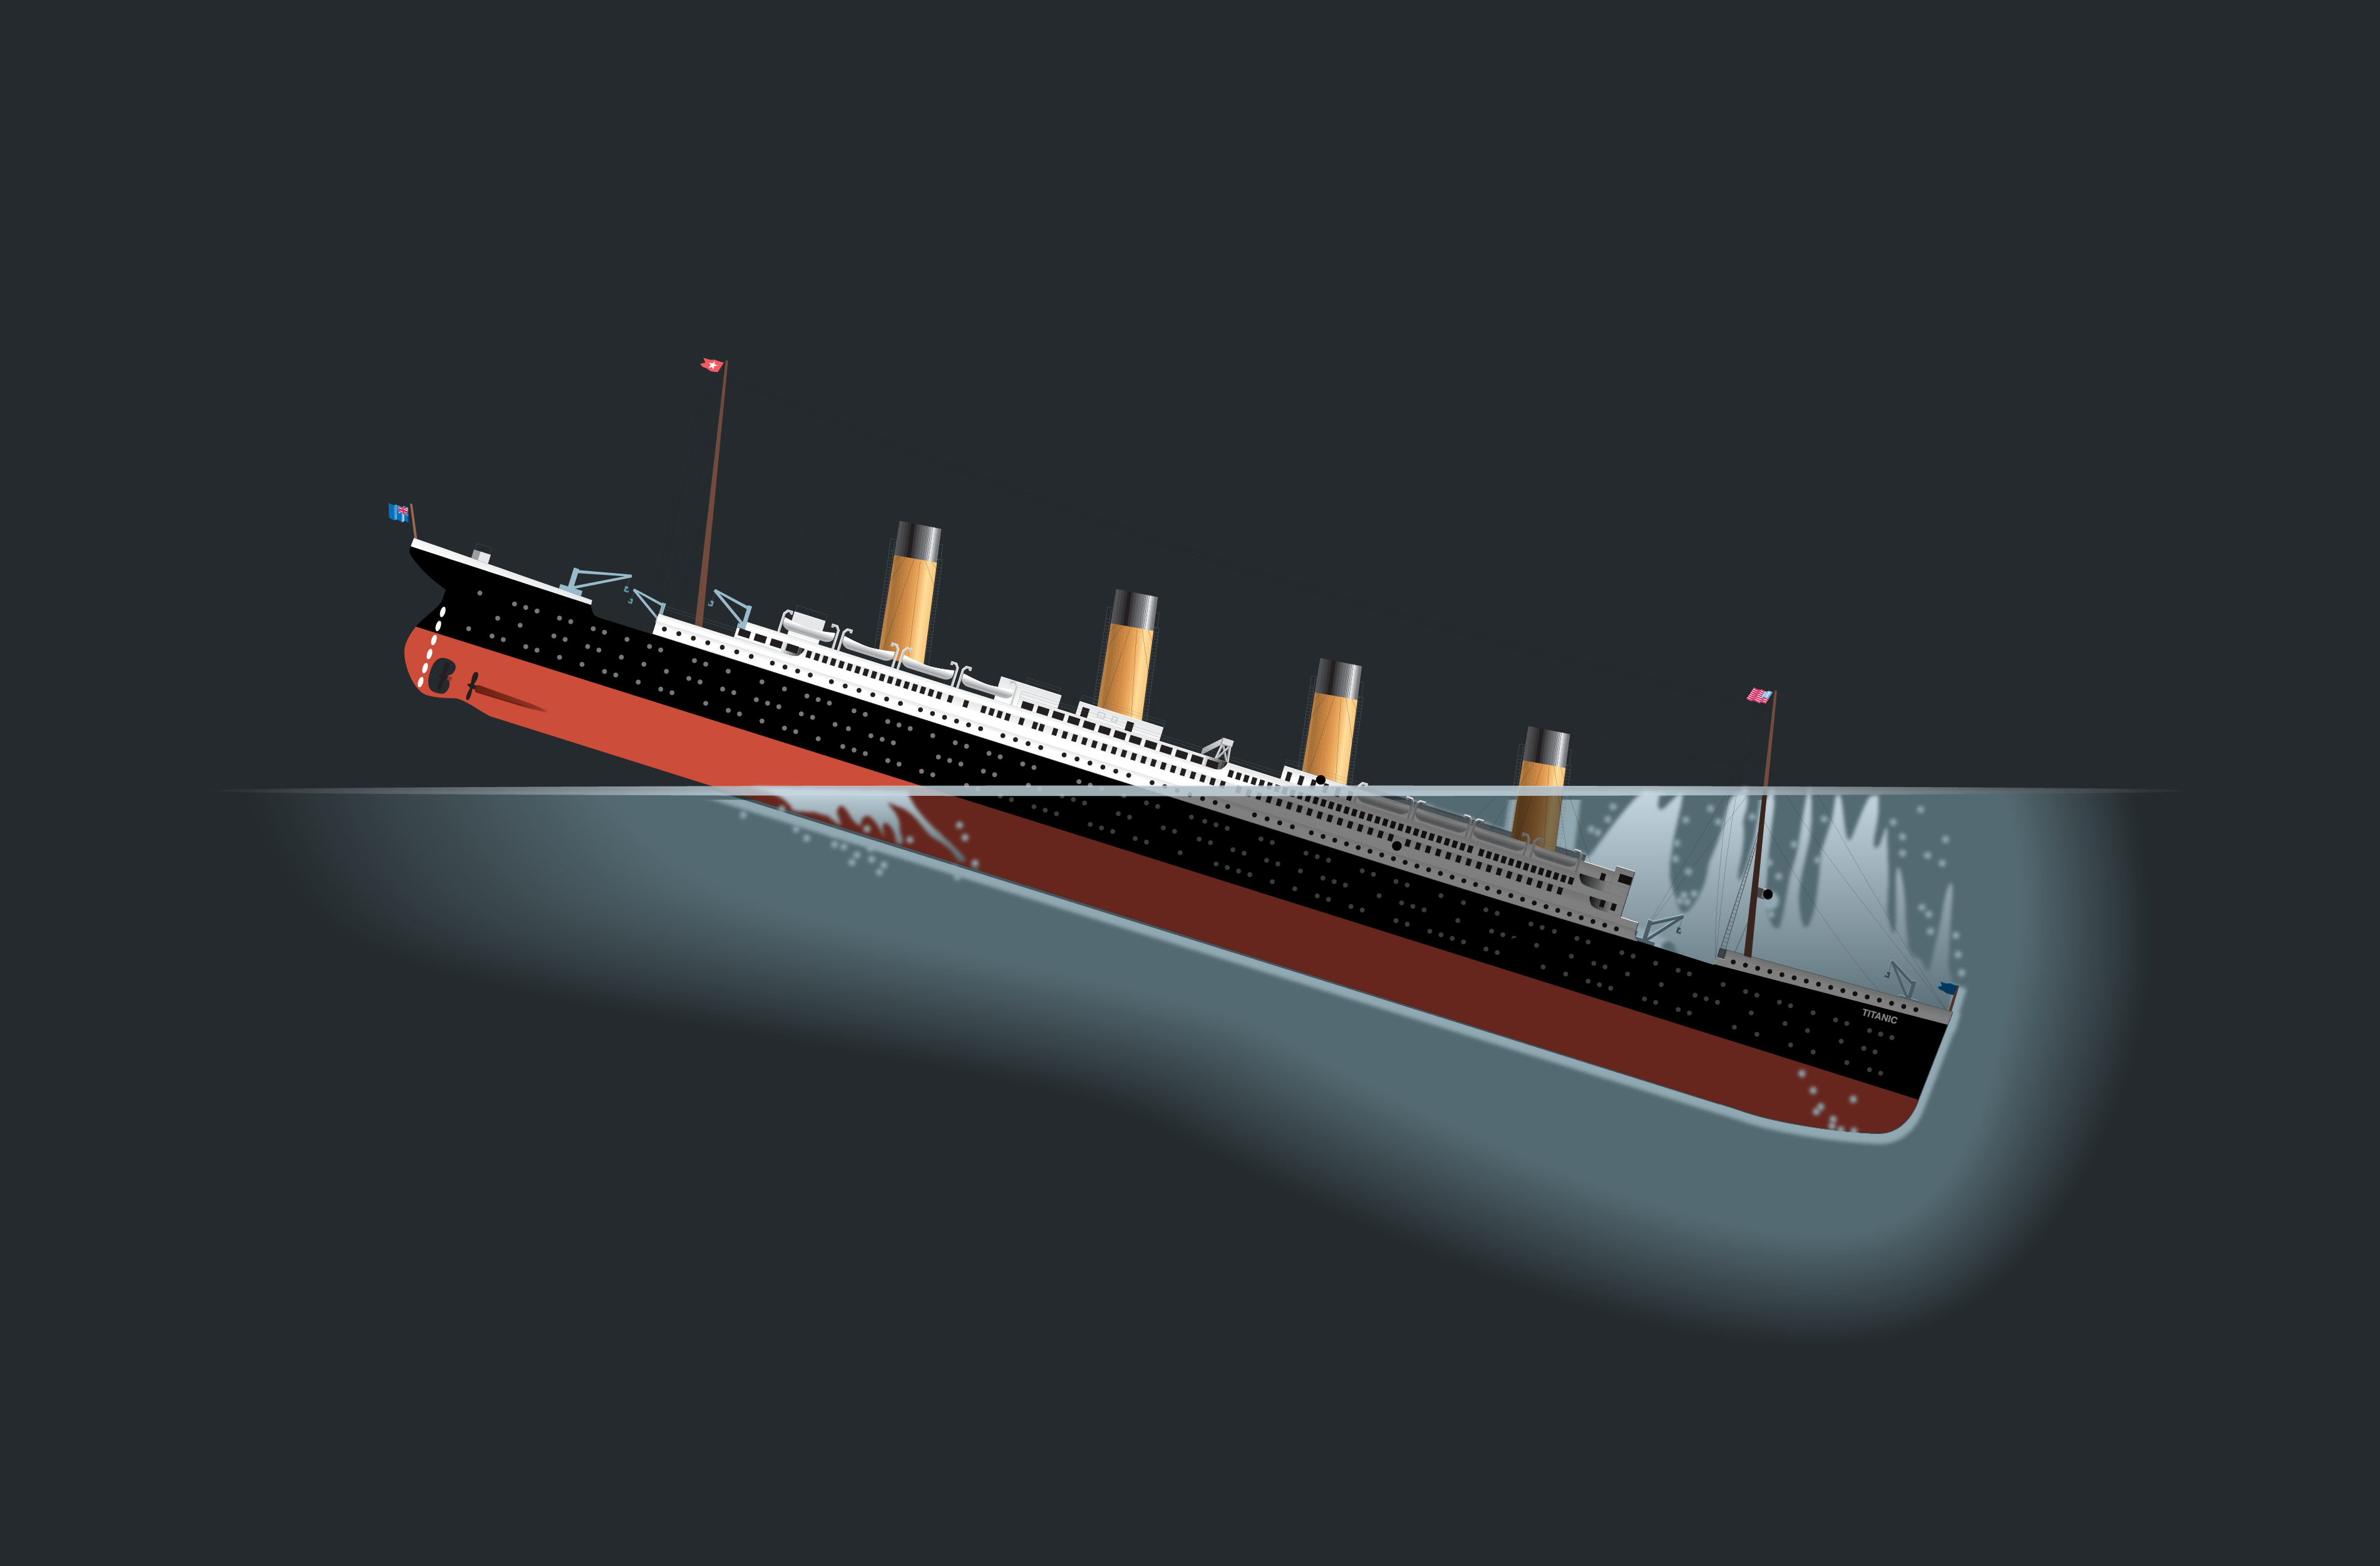

The Quest for the Titanic Logistic Regression
Irina

Slide 2
The Data
On April 15, 1912, during her maiden voyage, the widely considered “unsinkable” RMS Titanic sank after colliding with an iceberg, resulting in the death of 1502 out of 2224 passengers and crew
Data set contains information on 891 passengers, with columns including PassengerID, Survived or not, Cabin class, Name of passenger, Sex, Age, Number of siblings on board, Number of parents/children on board, Ticket number, Fare, Cabin, and where the passenger embarked onto the ship

Slide 3
The Quest
In this challenge, we ask you to build a predictive model that answers the question: “what sorts of people were more likely to survive?” using passenger data (ie name, age, gender, socio-economic class, etc)

Slide 4
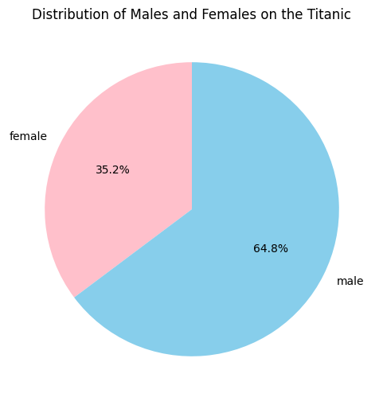
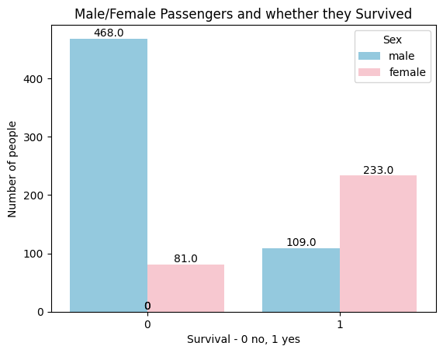
EDA – male vs female passengers

Slide 5
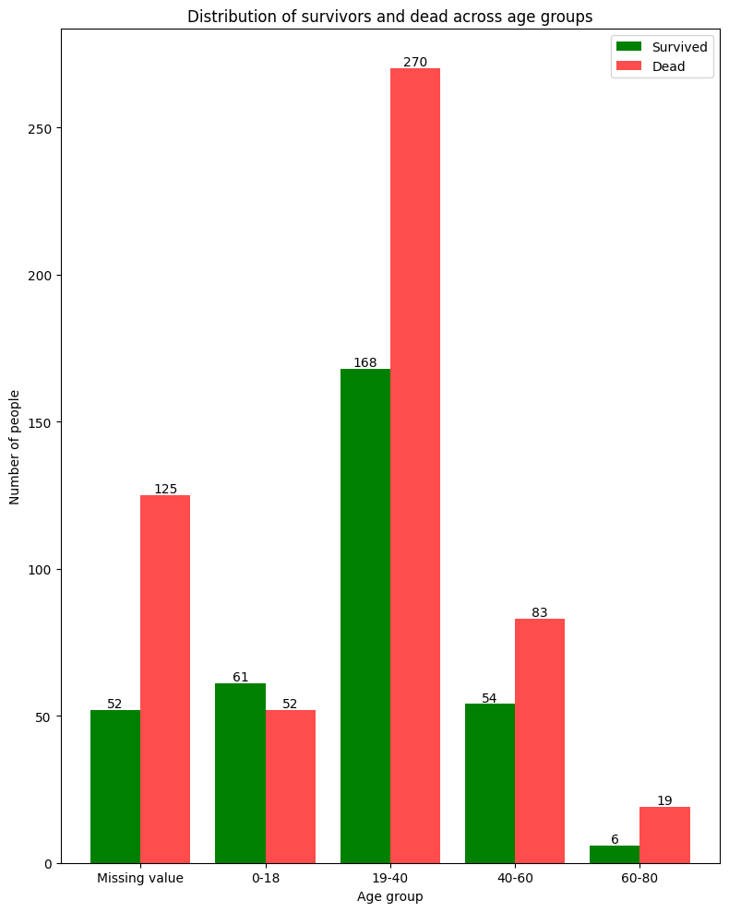
Age groups - missing values - 0-18 - 19-40 -40-60 -60-80

Slide 6
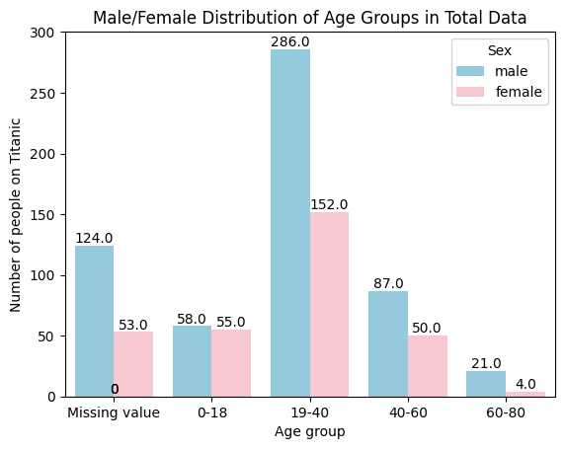

Slide 7
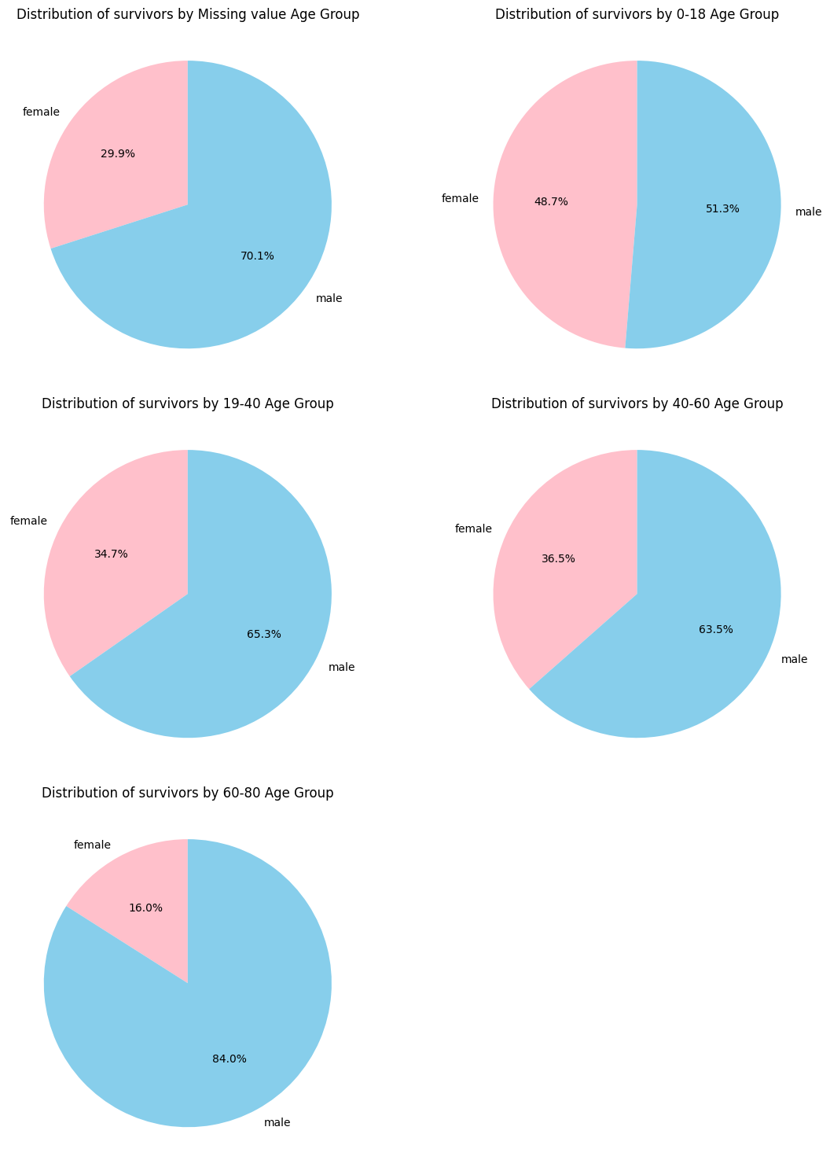

Slide 9
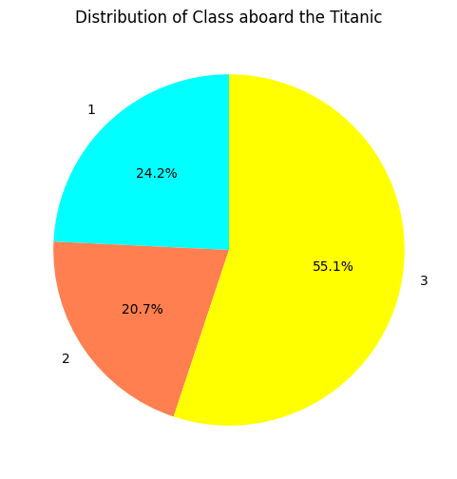
Cabin class on the Titanic

Slide 10
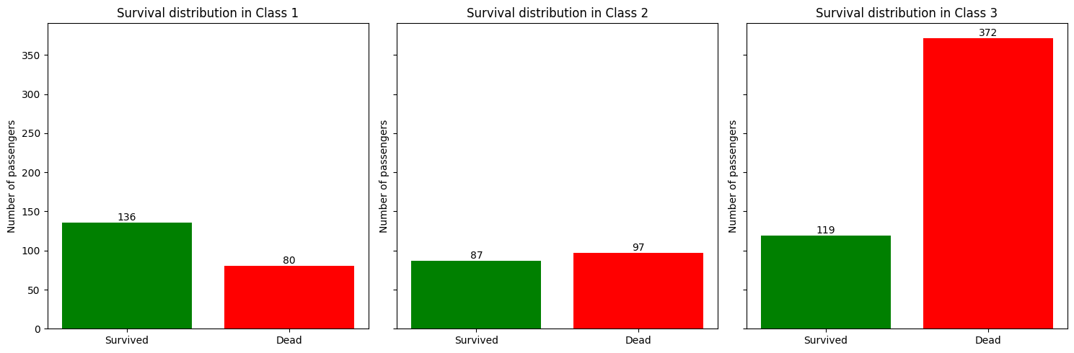
Survival according to cabin class

Slide 11
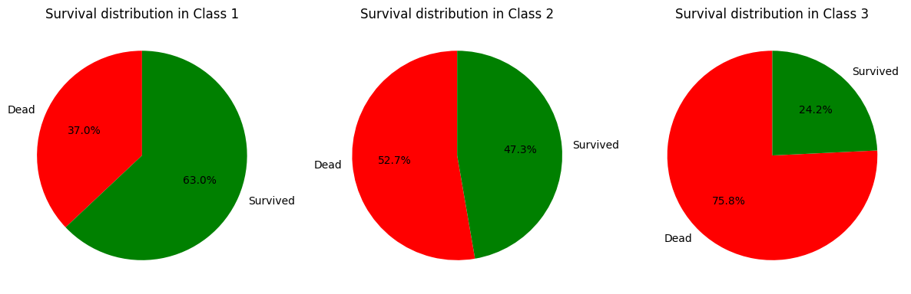

Slide 12
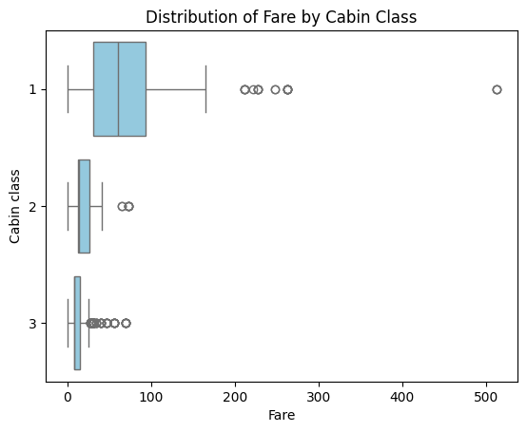

Slide 13
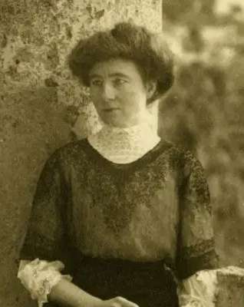
Who is this number that’s so far off the plot???
Meet Anna Ward
Ticket price £512
Worked as a maid for the Cardeza family
Why would a maid pay £500 for a ticket??

Slide 14
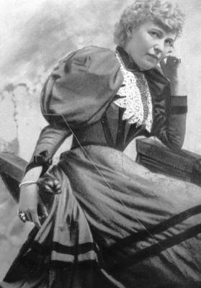
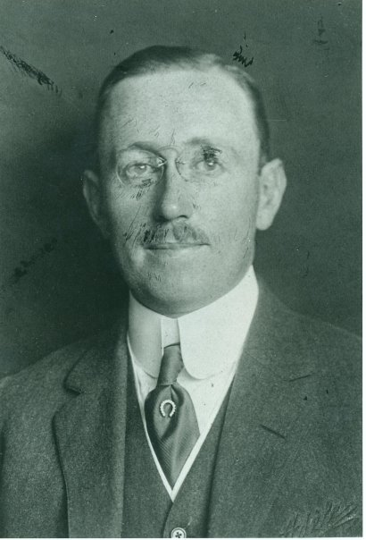
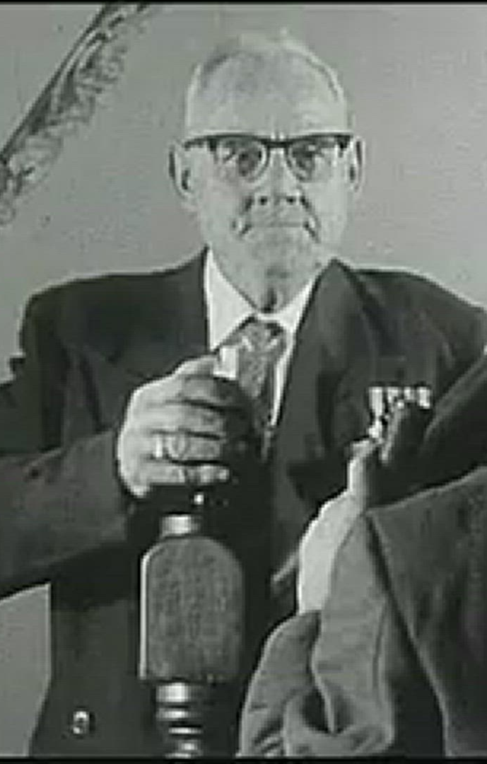
All these people also paid £512 for their ticket – if each person paid this fare, it would be £512x4 -> £20148
However records suggest that the payment was for a cabin, rather than per person
Seems much more likely Mr Cardeza paid for everyone
Charlotte Wardle Cardeza
- wealthy widow
- Anna’s employer
Thomas Drake Cardeza
- son to Charlotte
- wealthy banker
Louis Gustave Joseph Lesueur
- manservant to Thomas

Slide 15
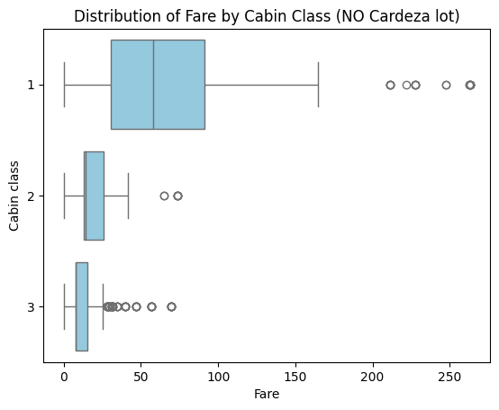

Slide 16
Ok, so people have the value of the ticket written next to them even if they haven’t paid right?
No.

Slide 17
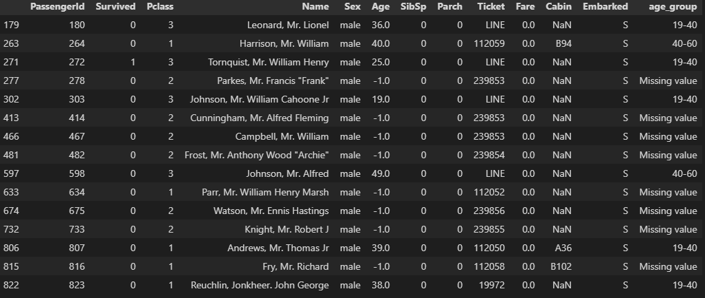
Meet the zero-fare passengers

Slide 18
Turns out the fare data is inconsistent
Highly unlikely that they did not pay anything on the highly prestigious RMS Titanic, especially given some passengers are first class – so did someone else pay for them? Were they sharing a cabin?
Note that 8 of these passengers have missing age values and did not survive – missing information in general?
Unlikely to be stowaways

Slide 19
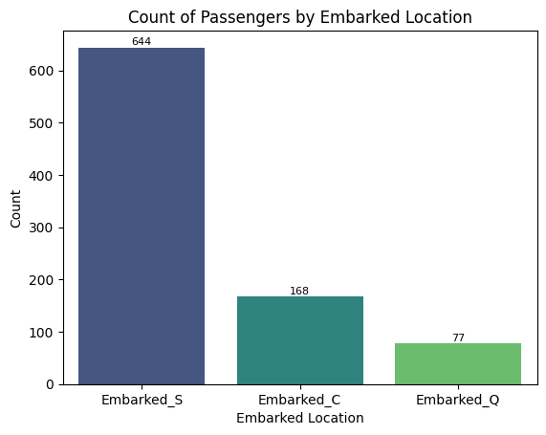
Embarked Location
Southampton UK
Cherbourg FR
Queenstown Ireland

Slide 20
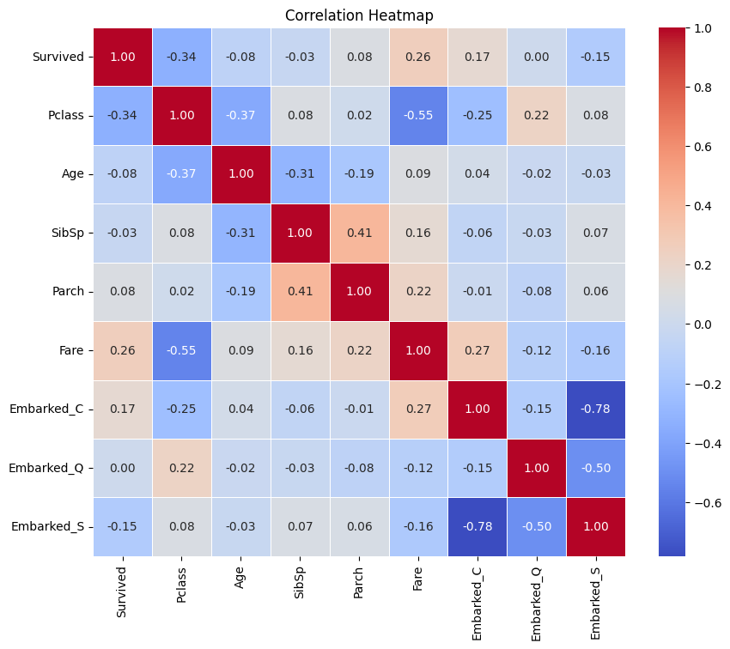
No correlation between location of embarkment and survival
Small negative correlation: Higher cabin class likely to have embarked at Cherbourg in France or Queenstown in Ireland

Slide 21
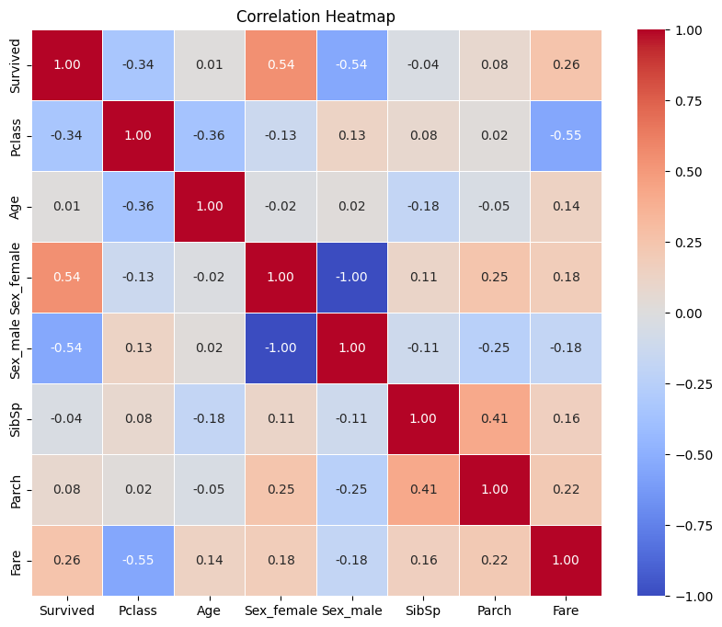

Slide 22
What I could do further
Correlation with embarked location does not contain sex – could also add this variable
Further investigate number of siblings and number of dependents – moderately strong correlation between these values

